Slide 1


Slide 2
Digital Seismometer with Earthquake Analyzer

Slide 3
Introduction

Slide 4
Goals and Objectives
To create an affordable digitizer equipment as an alternative to the digitizer system used by PHIVOLCS.
To create an online database which will be used as a storage for all files generated by the digitizer system.
To create an API which will be used as an interface between application software and online database.
To create a C# Earthquake Analyzer software as a sample program that uses an API to communicate to the online database for data.
To display and manage the digitized x, y, and z values using an Android Phone.

Slide 5
Scopes
The system has the capability to convert three analog signals from the accelerometer into three 24-bit digital data and send it to the Android phone.
The Android software will store the converted data into a single file. The single file will contain location, output data speed, compass, date and time information.
The Android software will compress the file every hour and send it to the database. It will automatically back-up the file if there is no connection to the database.
The C# software has the capability to analyze seismic wave coming from data in the database.

Slide 6
Project Constraints and Limitations
Data can only be accessed in the database and external storage of Android Phone. Data in the external storage can only be accessed during connection lost to the database.
The digitizer should always be connected to the Android phone through USB.
The earthquake analyzer software will only work on data based on unit “g”.
The calculated value of magnitude will only have a rough estimation.

Slide 7
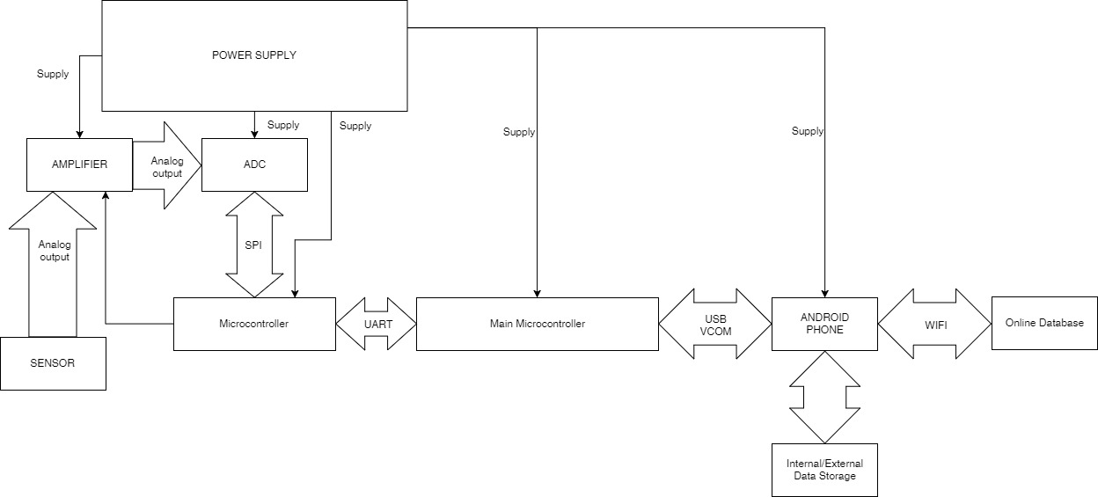
System Architecture

Slide 8
Functionalities
Analog to Digital Converter
The AD Converter will be used to convert the three analog signals of x, y, and z into three 24-bit digital data.
Data Management
Android software will append the data from the digitizer into single file. The file contains location, time, compass, and output data speed. After an hour of data gather, the file will be compressed and send to database. It will automatically generate back-up when connection is lost.

Slide 9
Functionalities
Android Data Display
This project uses an Android to display the digital data x, y, and z continuously as long as the Android phone receives those data.
Application Programming Interface
This project uses an API to communicate with the database.
Earthquake Analyzer
This project includes the creation of C# Earthquake Analyzer software which will used the data from the database to analyze seismic movements.

Slide 10
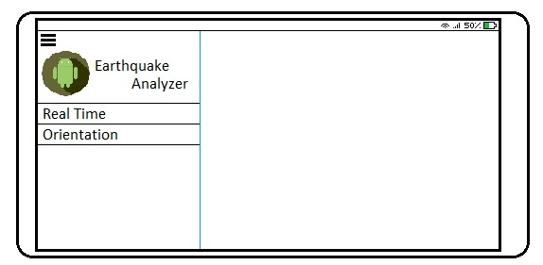
User Interface

Slide 11
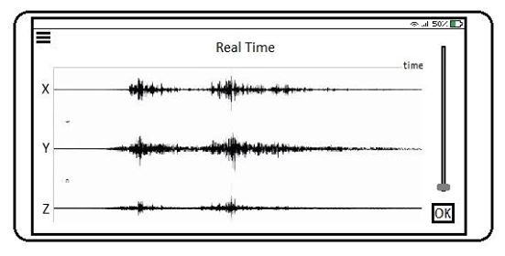
User Interface

Slide 12
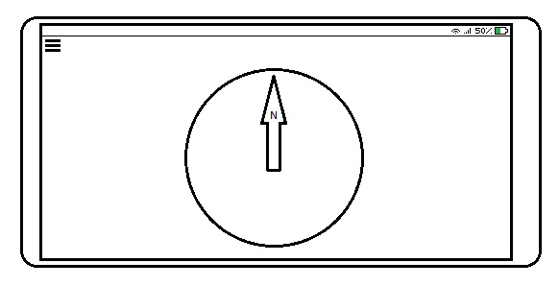
User Interface

Slide 13
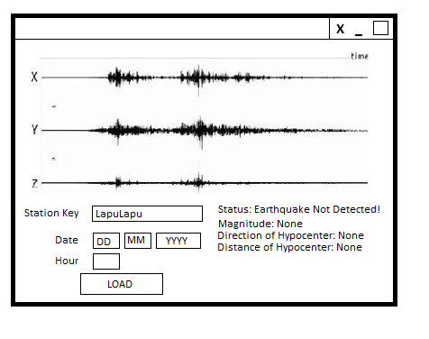
User Interface

